Slide 1


Department of Data Science
Bishop Heber College, Trichy
Detection based Multi-Object Tracking using
YOLO-V7 & Deep-SORT
for Autonomous Vehicle
Name : Sharon Sam Simpson
Roll No : 215229137

Slide 2
Objective of the Project
To detect and determine the presence of different number of objects
To classify the object accordingly
To keep track of the detected object identities
To help the autonomous vehicle for it’s navigation from the information above

Slide 3
Abstract
The detection and tracking of objects around an autonomous vehicle is essential to operate safely.
The proposed approach uses state of the art deep-learning network YOLO-V7 to detect and classify the objects.
This information integrates with DEEP-SORT model to keep track of the objects.
The resultant solution aids in the localization of the vehicle about its environment so that it can safely navigate the roads autonomously.

Slide 4
Introduction
Topic taken from IEEE/RSJ International Conference on Intelligent Robots and Systems (IROS)
Object tracking is the process of locating the moving objects over time in videos.
Object tracking has a variety of use cases such as
surveillance and security
traffic monitoring
video communication
robot vision and animation
gaming

Slide 5
Problem Description
Information – sensors such as LiDAR, cameras and GPS
The autonomous vehicle must be able to localize itself in an environment
It should also able to identify and keep track of objects – traffic tracking
Information helps the vehicle to successfully navigate from one point to another
Data source – cameras

Slide 6
Need for present work
Need for present work:
Siamese network requires data in which future frame is uncertain in this case
Usage of LiDAR costs is very high
Associating new detections with the new predictions
Computation are complex
Fast hardwares such NVIDIA GPU
Benefits of doing this project work:
Lower the costs
Usage of Yolo-v7 & Deep-sort aids in increasing the overall performance

Slide 7
Literature Review
Year | Topic | Authors | Technique | Limitations
2020 | Dynamic Object Tracking for Self-Driving Cars Using Monocular Camera and LIDAR | Lin Zhao, Meiling Wang, Sheng Su, Tong Liu, and Yi Yang | Siamese network, Semantic Segmentation, RTM | Usage of Siamese network requires the data for future frame is uncertain, NVIDIA GPU cost is high
2019 | Implementation of Human Tracking System under Different Video Degradations | Ghadir Mostafa Diab, Nada EL-Shennawy, Amany Sarhan | Kalman filters | Problem lies in associating new detections with the new predictions
2015 | Moving Object Tracking using Optical Flow and Motion Vector Estimation | Kiran Kale, Sushant Pawar, Pravin Dhulekar | Optical Flow, Median Filter, Motion Vector | Susceptible to noise and illumination, computationally complex, requires fast hardware & softwares

Slide 8
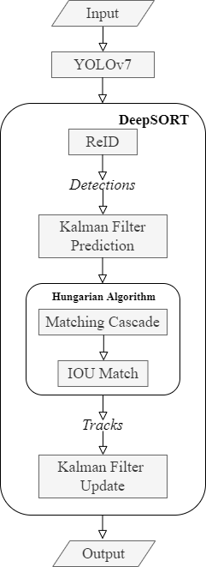
Work Flow Diagram

Slide 9
Methodology
Techniques involved:
Object Tracking = BB Detections (YOLO-V7) + Tracker (DEEP-SORT)
Stages in Object tracking:
Target initialization – drawing bounding boxes
Motion estimation – predict object future position
Target positioning – localization of the target

Slide 10
Methodology
YOLO-V7:
SOTA(state-of-the-art) real time object detection model
Pre-trained model upon COCO dataset consists of 80 different object classes
One-stage detector – ROI is not selected
Components:
Backbone – extracts essential features (Feature Formation)
Neck – collects feature maps and creates feature pyramids (Feature Aggregation)
Head – consists of output layers that have final detections (Detection)

Slide 11
Methodology
Architectural Reforms:
E-ELAN (Extended Efficient Layer Aggregation Network)
- computational block, enhance the learning ability of the network.
Model Scaling for Concatenation-based Models
- compound model scaling approach, width and depth are scaled in coherence.
Trainable BOF (Bag of Freebies):
Re-parameterized convolution
- improves the inference results, outputs were ensemled to obtain the final model.
Coarse for auxiliary and Fine for lead loss
- A fine label to train the lead head A set of coarse labels to train the auxiliary head.

Slide 12
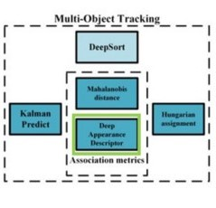
Methodology
DEEP-SORT :
Popular Object tracking algorithms.
Deep-Sort = SORT + DNN
SORT is Simple Online Real-time Tracker, which is online-based (use past & present information)
Components:
Detection – object of interest in initial stage I
Estimation – predicting future location i+1 using kalman filter
Association – optimization using Hungarian algorithm

Slide 13
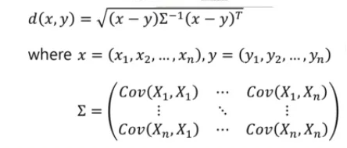
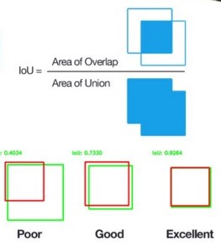
Methodology
Assignment Problem:
Distance metric – Mahalanobis distance
(quantify the association)
Efficient algorithm – Hungarian algorithm
(associate the data)

Slide 14
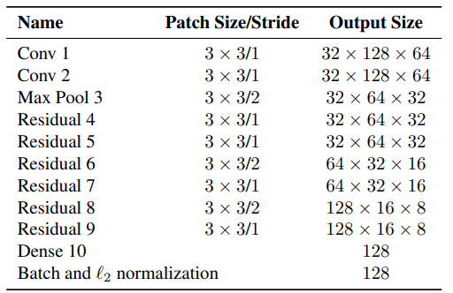
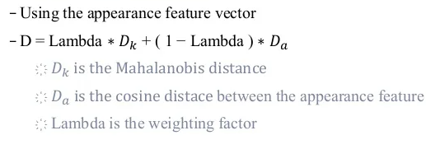
Methodology
Apperance descriptor:
Kalman filter – fails the real world scenarios.
Distance metric – based on appearance of the object
Classifier is build without the final classification layer – feature vector

Slide 15

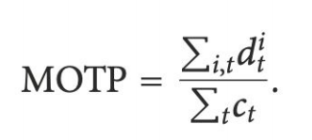
Results & Discussion
MOTA (Multi-Object Tracking Accuracy):
combines three error sources: false positives, missed targets and identity switches.
MOTP (Multi-Object Tracking Precision):
bounding box overlap between ground-truth and reported location.
IDF1 (ID F1 Score):
ratio of correctly identified detections over the average number of ground-truth and computed detections.
FP:
total number of false positives.
FN:
total number of false negatives (missed targets).

Slide 16
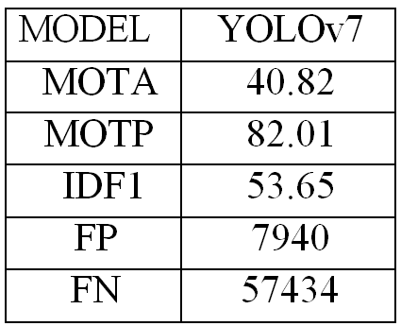
Tracking Results

Slide 17
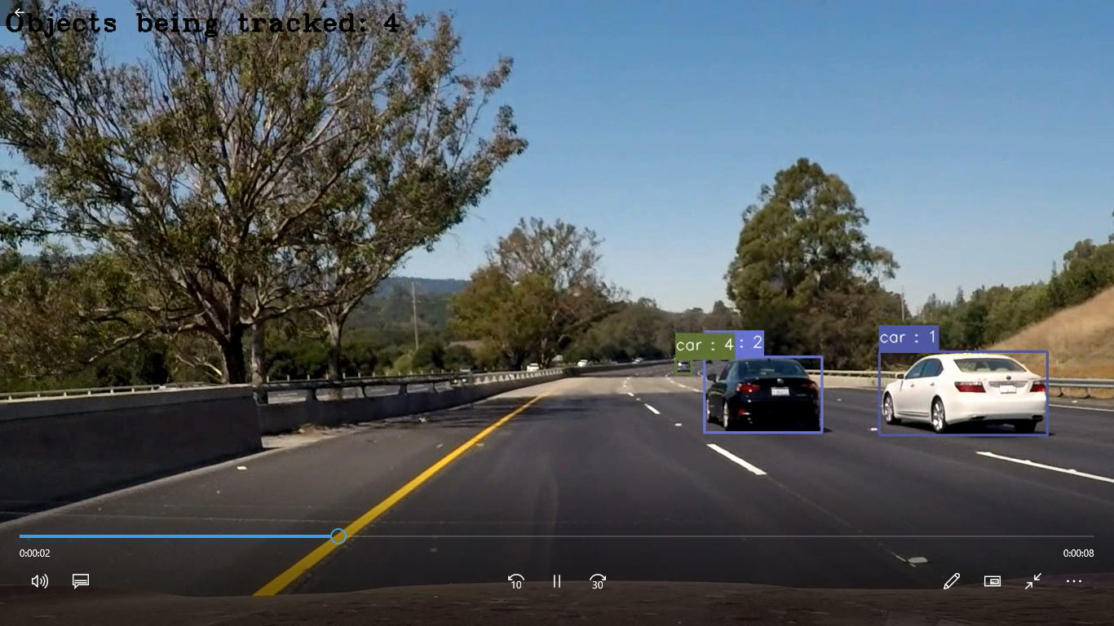
Tracking output - video
Yolov7-Deepsort

Slide 18
Conclusion
In recent years, with the rapid development of deep learning, the scheme of detection based tracking (DBT) has been born.
It has quickly become the mainstream framework of current MOT, which greatly promotes the progress of MOT tasks.
Further works:
Information of the instances and objects tracked in the given data, it is feed into the machine to process the data and take necessary controls to be taken for navigating the self-driving cars.

Slide 19
References
1. Dynamic Object Tracking for Self-Driving Cars Using Monocular Camera and LIDAR
Lin Zhao, Meiling Wang, Sheng Su, Tong Liu, and Yi Yang, 2020
2. Implementation of Human Tracking System under Different Video Degradations
Ghadir Mostafa Diab, Nada EL-Shennawy, Amany Sarhan, 2019
3. Moving Object Tracking using Optical Flow and Motion Vector Estimation
Kiran Kale, Sushant Pawar, Pravin Dhulekar, 2015

Slide 20
Thank you

